Slide 1

Movie Gross Revenue Estimation
VII Semester Project
Project Mentor and Guide:
Dr. Sonali Agarwal

Slide 2

Team Members
Abhishek Kumar Agrawal(IIT2013128)
Shubham Bhendarkar (IIT2013172)
Shaiwal Sachdev (IIT2013196)

Slide 3

Problem Definition
The goal of this project is to develop a model that will be able to estimate the Box Office Gross Revenue of a film after its first weekend of release.
The analysis is based on USA region only.

Slide 4
Motivation
This model is useful for :
Movie producers and Production studios as by looking at estimated values of revenue, they can take different steps on deciding the budget for things like marketing, promotion,etc.
Movie theatres as they can also estimate the amount of money they will be able to collect on screening the movie.

Slide 5
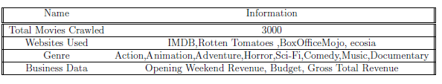
Data Set
Data is collected through crawling and scraping movie webpages of websites like IMDB, rottentomatoes, BoxofficeMojo,Metacritic etc.
Revenue data is collected from IMDB Business page of each movie.
All the revenue data is of USA region only.
We collected the data for movies released from year 2000 to 2015 only.

Slide 6
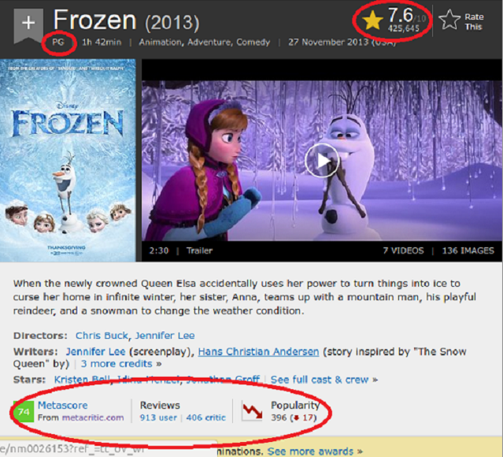
IMDB

Slide 7
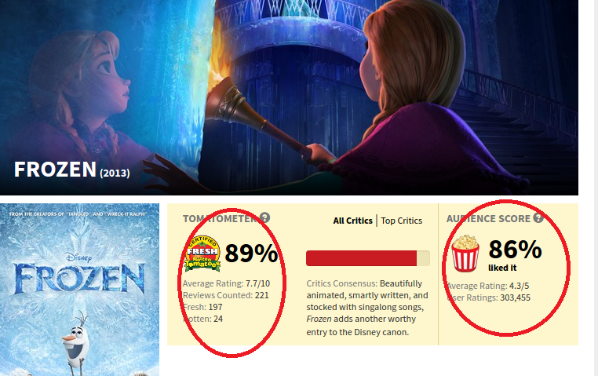
ROTTEN TOMATOES

Slide 8
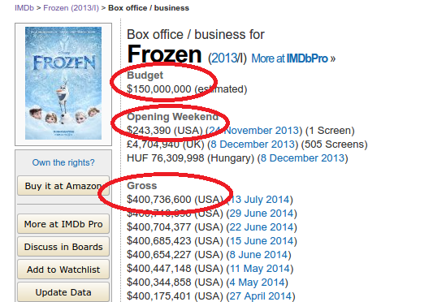
IMDB Business Page

Slide 9

Fields Information
The fields collected are :
1. Title of Movie
2. Genre (Action,Animation,Adventure,Horror,etc.)
3. Release Date
4. Budget of the movie
5. Opening Weekend revenue for USA
6. Number of Screens in opening weekend
7. Total runtime of the movie
8. MPAA Film rating
9. Rotten Tomato Critic Rating
10. Userrating from Rotten Tomato
11. Gross Domestic Revenue for USA
12. MetaScore from Metacritic
13. Popularity of the Movie
14. IMDB User Rating

Slide 10
Proposed Approach

Slide 11
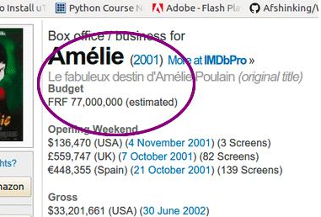
Data Cleaning
1. Removing Movies data with no revenue data.
2. Bringing the data to proper format like removing commas , dollar sign, dealing with words like "million" , that is anything other than numeric data.
3. Dealing with Unicode characters in
title of the movie.
4. Removing inconsistent data.
5. Budget of the movie was in
different currencies . Currency Conversions had to
be done for converting all this data to US Dollars.
6. Converting revenue data to numeric fields.

Slide 12
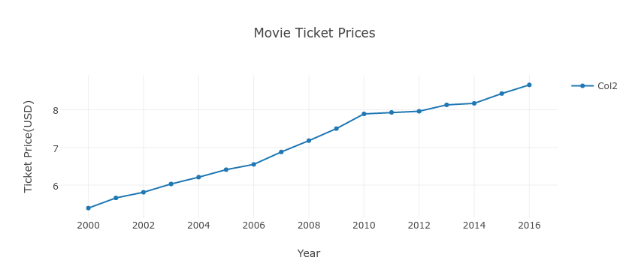
Data Transformation
Due to inflation price of tickets have changed so much over the years. We used this change in ticket price and as inflation parameter and calculated the inflation adjusted revenue data for each movie. Current Ticket Price in 2016 is 8.66 USD.
Source : Wikipedia

Slide 13


Estimation Using Regression Models
Assuming linear relationship between gross revenue and other features we collected , to measure the linear dependence we calculated the correlation parameter.
Error for Regression Model is computed using MAPE(Mean Absolute Percentage error).

Slide 14
Genre Based Regression Analysis
We then applied a multiple linear regression model with features budget of the movie, number of screens ,opening weekend revenue to predict the gross revenue. Error was around 130 percent.
As per the journal paper, different types of movies respond to different parameters differently. So, we decided to split the dataset by genre of the movie and do further analysis. We then found out all the subsets of the set of features.
We then calculated the error for each genre for each subset of features.
This way we are making a model that will change its set of input parameters required based on type of movie.
Picking up the combination with minimum percentage error for each combination
Prag, J.J. Casavant, J. 1994. An empirical study of the determinants of revenues and marketing expenditure in the motion picture industry’s, Journal of Cultural Economics,

Slide 15
Genres
We found 18 genres in the dataset .
For all the genres , we run the code for each subset of the set of features and find out the subset for the genre which gives minimum Percentage Error or MAPE.
Action | Adventure | Comedy
Animation | Crime | Horror
Documentary | Biography | Drama
Sci-Fi | Romance | Thriller
Family | Fantasy | History
Mystery | Sport | Music

Slide 16
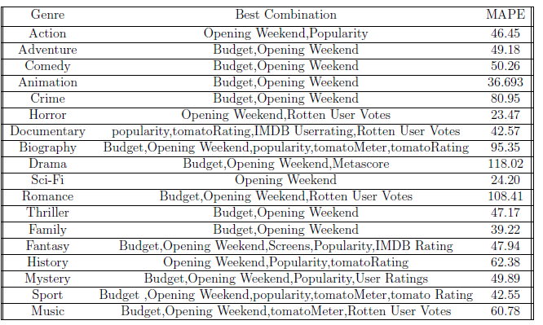
Result

Slide 17
Conclusion
From the result table showing the genre and best combinations with percentage error:
Shows that the Budget of Movie doesn't seem to affect the gross revenue of Horror, Documentary,Sci-Fi,History movies therefore it should not be taken as a parameter in regression while doing estimation for them.
Opening Weekend is the most important feature that is present in all of the genres.
Critic Rating doesn't seem to affect the performance of a lot of movies. Only Documentary, Biography,Drama,History Sport,Music are affected a bit.
Budget and Opening Weekend seem to make the best combination.
Paper : Alec Kennedy. Predicting Success: Do Critical Reviews Really Matter? 2010.

Slide 18

Technology Used:
Tools Used :
Scikit Learn
LaTeX
miniconda
matplotLib
BeautifulSoup
Google API
Rotten Tomatoes API
Language Used:
Python

Slide 19
Things to do Post Mid-Sem:
Currently, we have calculated the MAPE error on the genre basis. These things we will do post mid semester:
Finding other models of regression trying to decrease the error.
We are looking forward to decrease percentage error by collecting more data and removing outliers.
Dealing with movies with more than one genre.
Making use of categorical variables like MPAA rating,etc.
Instead of predicting a exact value we will try to predict the value in a specied range. Classes will the buckets of gross revenue. Basically, saying this can also be seen as a classication problem.

Slide 20


